Slide 1
The Cross & The Kingdom 1
Living In the Kingdom – Part 6
Old Testament vs. New Testament

Slide 2
Dead To The Law
Matthew 11:11-14 Truly I say to you, Among those who have been born of women there has not risen a greater one than John the Baptist. But the least in the kingdom of Heaven is greater than he. (12) And from the days of John the Baptist until now the kingdom of Heaven is taken by violence, and the violent take it by force. (13) For all the Prophets and the Law prophesied until John. (14) And if you will receive it, this is Elijah who is to come.
Romans 7:4 So, my brothers, you also have become dead to the law by the body of Christ so that you should be married to Another, even to Him raised from the dead, that we should bring forth fruit to God.

Slide 3
From Law To Spirit
Romans 8:1-4 LITV There is therefore now no condemnation to those in Christ Jesus, who do not walk according to flesh, but according to Spirit. (2) For the Law of the Spirit of life in Christ Jesus set me free from the law of sin and of death. (3) For the Law being powerless, in that it was weak through the flesh, God sending His own Son in the likeness of sinful flesh, and concerning sin, condemned sin in the flesh, (4) so that the righteous demand of the Law might be fulfilled in us, those not walking according to flesh, but according to Spirit.
Galatians 5:16-18 LITV But I say, Walk in the Spirit, and you will not fulfill the lust of the flesh. (17) For the flesh lusts against the Spirit, and the Spirit against the flesh; and these are contrary to one another; lest whatever you may will, these things you do. (18) But if you are led by the Spirit, you are not under Law.

Slide 4
Heavenly Realms
The Cross extends into the Resurrection to new life and into the Ascension where we are seated with Christ in the Heavenly realms with authority:
Ephesians 2:4-7 MKJV But God, who is rich in mercy, for His great love with which He loved us (5) (even when we were dead in sins) has made us alive together with Christ (by grace you are saved), (6) and has raised us up together and made us sit together in the heavenlies in Christ Jesus, (7) so that in the ages to come He might show the exceeding riches of His grace in His kindness toward us through Christ Jesus.

Slide 5
Discussion 1
Discussion: What are some of the huge spiritual changes that the Cross makes between the Law and the Gospel?

Slide 6
Access = Authority
This new heavenly status of Christians is reflected in practical ways (we can now cast out demons with authority whereas no one in the Old Testament could do so) and in theological and spiritual ways such as in the grace in which w stand and in our access to the throne-room of God.

Slide 7
Commissioned Authority
Matthew 28:18-20 MKJV And Jesus came and spoke to them, saying, All authority is given to Me in Heaven and in earth. (19) Therefore go and teach all nations, baptizing them in the name of the Father and of the Son and of the Holy Spirit, (20) teaching them to observe all things, whatever I commanded you. And, behold, I am with you all the days until the end of the world. Amen.
Luke 9:1 MKJV And He called His twelve disciples together and gave them power and authority over all demons and to cure diseases.

Slide 8
We Are Now In Zion
1 Corinthians 6:1-3 MKJV (1) Do any of you dare, when you have a matter against another, to go to law before the unjust, and not before the saints? (2) Do you not know that the saints shall judge the world? And if the world shall be judged by you, are you unworthy to judge the smallest matters? (3) Do you not know that we shall judge angels, not to mention the things of this life?
Hebrews 12:22-24 MKJV But you have come to Mount Zion and to the city of the living God, the heavenly Jerusalem, and to an innumerable company of angels, (23) to the general assembly and church of the first-born who are written in Heaven, and to God the judge of all, and to the spirits of just men made perfect, (24) and to Jesus the Mediator of the new covenant, and to blood of sprinkling that speaks better things than that of Abel.

Slide 9
Access To God
Romans 5:1-2 MKJV Therefore being justified by faith, we have peace with God through our Lord Jesus Christ. (2) Through Him we also have access by faith into this grace in which we stand, and we rejoice on the hope of the glory of God.
Hebrews 4:14-16 MKJV Since then we have a great High Priest who has passed into the heavens, Jesus the Son of God, let us hold fast our profession. (15) For we do not have a high priest who cannot be touched with the feelings of our infirmities, but was in all points tempted just as we are, yet without sin. (16) Therefore let us come boldly to the throne of grace, that we may obtain mercy and find grace to help in time of need.

Slide 10
The New Covenant
Hebrews 10:14-20 MKJV For by one offering He has perfected forever those who are sanctified. (15) The Holy Spirit also is a witness to us; for after He had said before, (16) "This is the covenant that I will make with them after those days, says the Lord; I will put My Laws into their hearts, and in their minds I will write them," (17) also He adds, "their sins and their iniquities I will remember no more." (18) Now where remission of these is, there is no more offering for sin. (19) Therefore, brothers, having boldness to enter into the Holy of Holies by the blood of Jesus, (20) by a new and living way which He has consecrated for us through the veil, that is to say, His flesh;

Slide 11
Discussion - 2
Discussion: What a) is our heavenly position?
b) is our heavenly access?
c) are our heavenly powers?

Slide 12
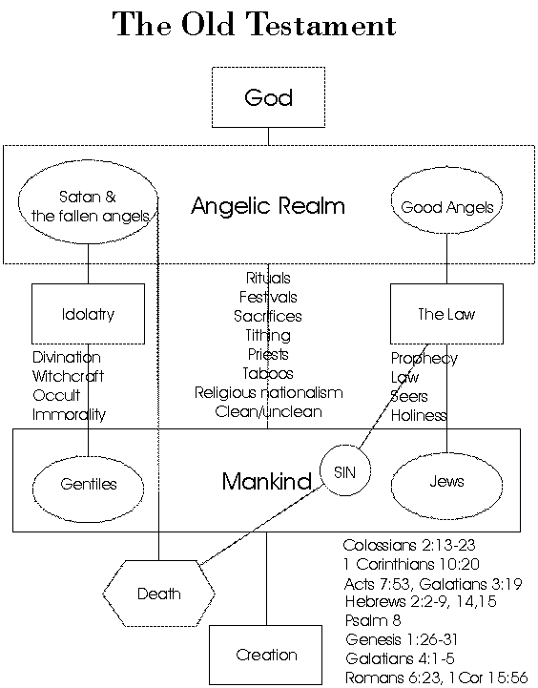

Slide 13
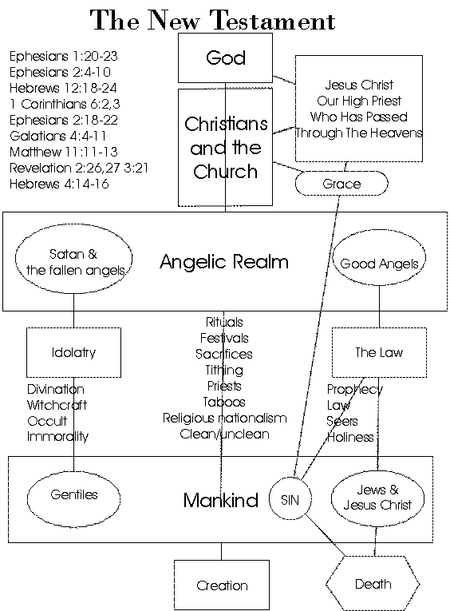

Slide 14
Scenario Question
You are talking to a strict Seventh-day Adventist who says you have to obey the dietary and other commands of the Old Covenant, how can you show them some of the key differences between the spiritual worlds of the Law and of the Gospel?

